Slide 1
Create a GUI in PowerShell
Module 10
Notes:
Version: 12/12/2019 17:20:43

Slide 2
Disclaimer

Slide 3
Learnings covered in this Unit
Windows Presentation Framework Introduction
Introduction to Visual Studio
Graphical User Interface Design
Advanced GUI Design
Code Behind a Form
Advanced Techniques

Slide 4
Windows Presentation Framework Introduction

Slide 5




Windows Presentation Framework
Available on all versions of windows with .NET 3+
WPF object are created using XAML
Now open source (since 2018) https://github.com/dotnet/wpf
XAML is an XML-based Mark-up language
This is used in C# with Visual Studio for Universal Windows Application GUIs
Utilizes DirectX instead of core windows components for better performance
WPF provides a standard set of editable GUI features
Notes:
Project "Avalon“ (WPF), was initially released 2006 with .NET 3.0

Slide 6
Why Use WPF in PowerShell
Turn your tool into something more user friendly
Gather input from a user with tools such as:
- Text boxes - Date pickers
- Submit Buttons
Display large, interactive data sets for output
- GUI can even adapt to screen resolutions and touch screens
WPF data binding is a feature that allows us to show live data changes in the GUI

Slide 7
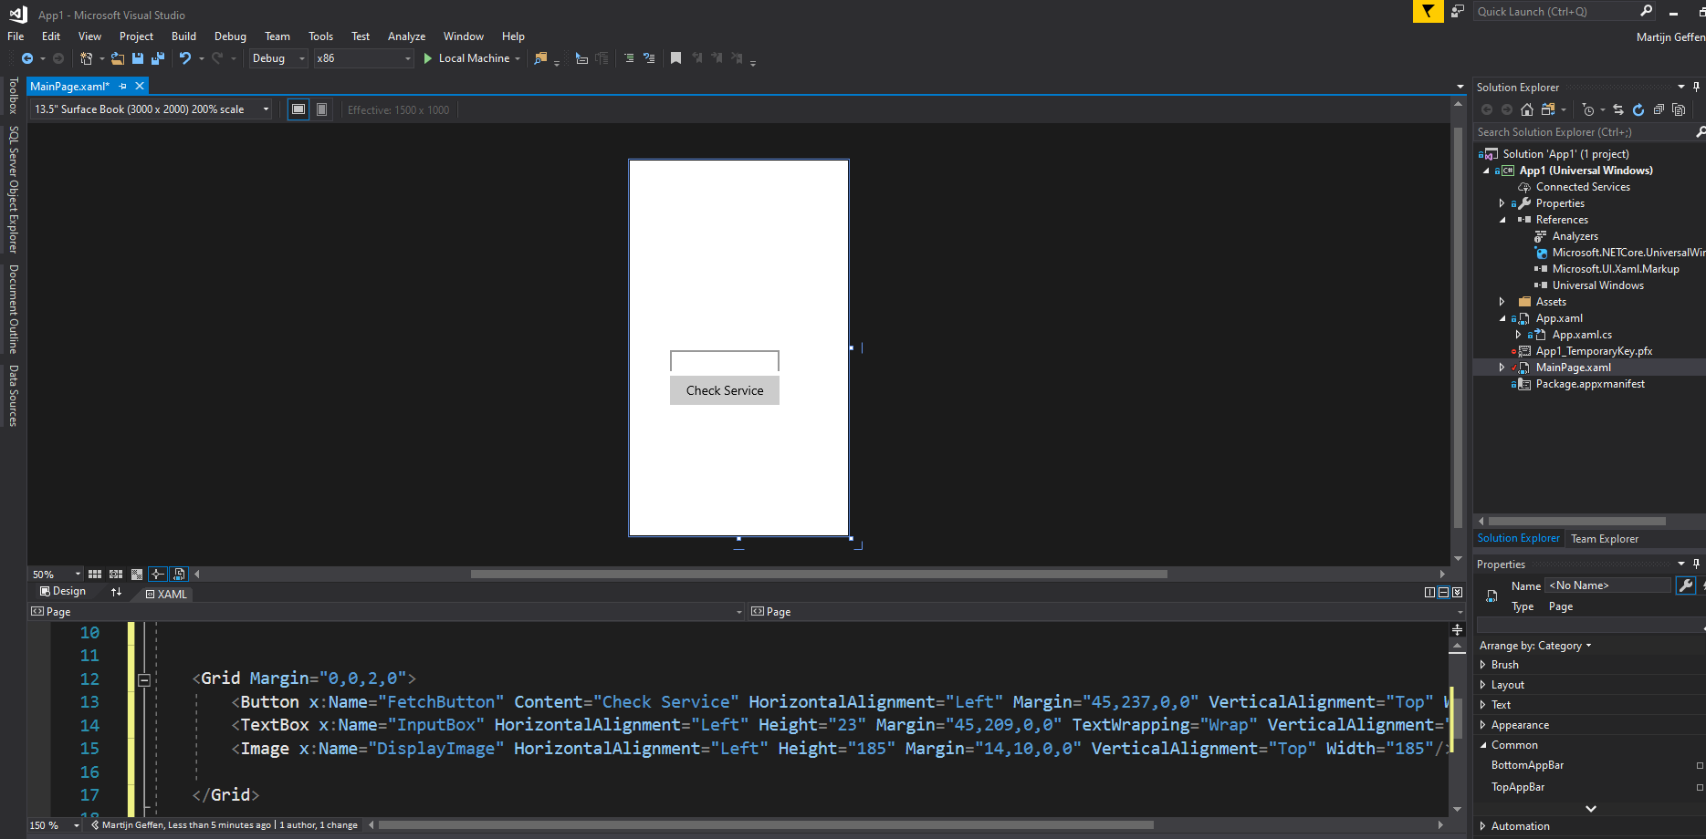
Tools to create XAML code (continued)
Visual Studio with C# WPF template
Notes:
With Visual studio (Any edition) you can create Rich XAML forms by creating a new C# WPF file.
https://docs.microsoft.com/en-us/windows/uwp/get-started/create-a-hello-world-app-xaml-universal
As a additional Tool VS Blend can be used to create new controls and visuals to extend upon the default .net set.

Slide 8
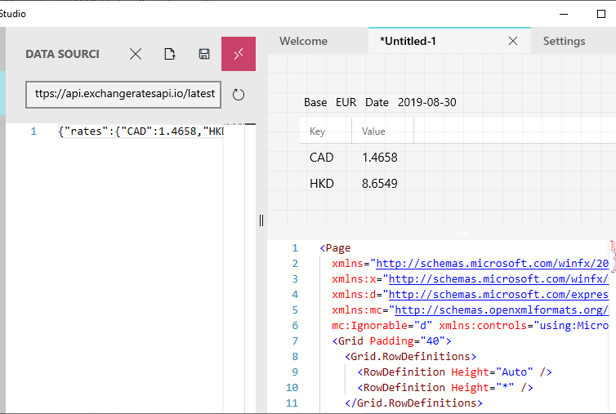
Tools to create XAML code
XAML Studio UWP app
Notes:
XAML Studio is a UWP app that shares part of its code with VScode so it has the same look and feel as VScode. You can build XAML code by dragging controls and use live data binding sources to build your XAML code pages.
https://aka.ms/XSTR_GarageBlog

Slide 9

Questions?

Slide 10

Introduction to Visual Studio

Slide 11
Why Use Visual Studio for XAML?
Powerful IDE for writing XAML or C# based GUI code
GUI for editing XAML code in real time
Changing an option in the rendered form causes VS to update the code and the opposite
Drag and drop functionality for adding new controls
Easy GUI guided based support for setting advanced options

Slide 12
Visual Studio Editions
Visual Studio Express
Free for everyone but discontinued
Visual Studio Community
Free for use on Opensource, Classroom training, Academic research
Not for Enterprise
Visual Studio Professional
Same version as community but for Enterprise
Visual Studio Enterprise
Same version as Professional but with extra tools (Mainly live testing and debugging)
Notes:
Versions compare
https://visualstudio.microsoft.com/vs/compare/

Slide 13

Visual Studio Versions
Currently in support major versions:
Visual Studio 2015
Visual Studio 2017
Visual Studio 2019
Extended support major versions:
Visual Studio 2010
Visual Studio 2012
Visual Studio 2013
Notes:
visual studio 2010 MSED 07/14/2015 - ESED 07/14/2020
visual studio 2012 MSED 01/09/2018 - ESED 01/10/2023
visual studio 2013 MSED 04/09/2019 - ESED 04/09/2024
visual studio 2015 MSED 10/13/2020 - ESED 10/14/2025
visual studio 2017 MSED 04/12/2022 - ESED 04/13/2027
visual studio 2019 (Current branch)
MSED -> Mainstream Support End Date
ESED -> Extended Support End Date

Slide 14
VS Installation for XAML Requirements
OS and system requirements:
Windows 8 or newer
.NET Version 3.5+
Visual studio options:
.NET desktop development feature
Custom XAML form controls:
Visual Studio Blend
Notes:
https://docs.microsoft.com/en-us/visualstudio/releases/2019/system-requirements

Slide 15
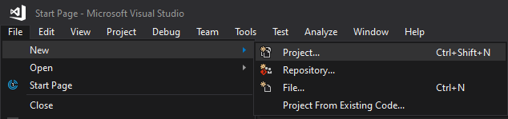
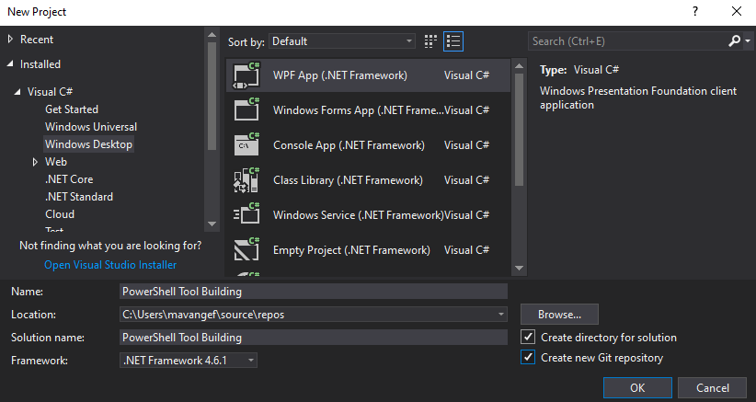
Creating a XAML project
File
New
Project
Windows Desktop
WPF APP
Name
Location
OK
Notes:
Create a new WPF Application project in Visual Basic or Visual C# named ExpenseIt:
Open Visual Studio and select Create a new project under the Get started menu.
The Create a new project dialog opens.
In the Language dropdown, select either C# or Visual Basic.
Select the WPF App (.NET Framework) template and then select Next.
The Configure your new project dialog opens.
Enter the project name ExpenseIt and then select Create.
Configure a new project dialog
Visual Studio creates the project and opens the designer for the default application window named MainWindow.xaml.

Slide 16
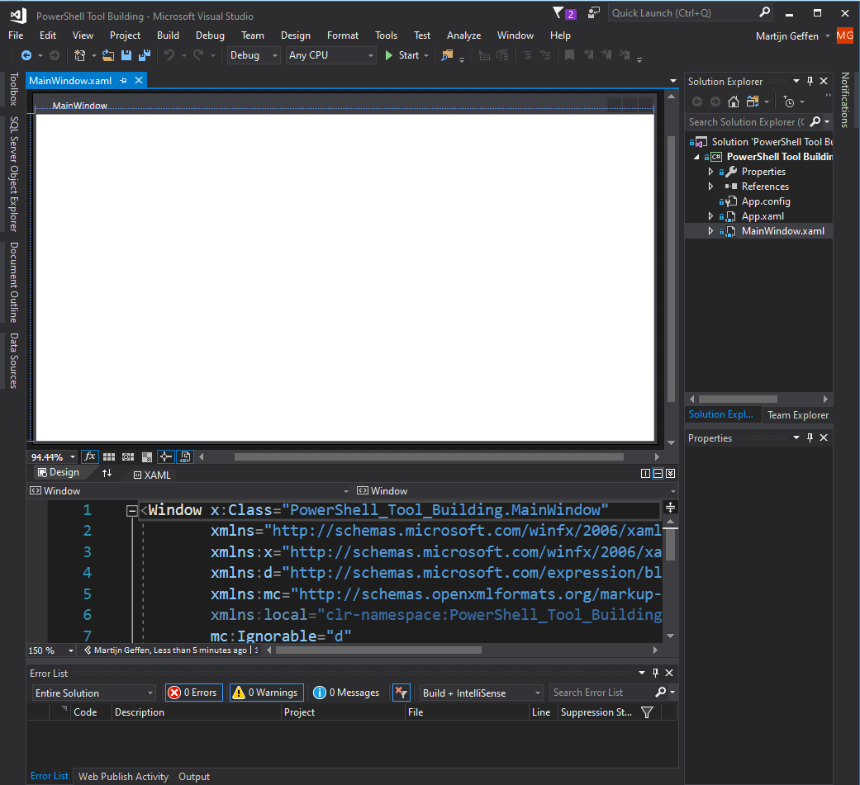
Visual Studio Layout
Solution Explorer
Open files in the solution
Focus on MainWindow.xaml
Tabs
Files that are open
Focus on MainWindow.xaml
Viewport
GUI with code behind
Code only

Slide 17
Visual Studio Layout (continued)
Flyout
WPF controls
Data connectors
Properties & Events
Selected object properties
Event triggers
Error List
Current solution Error and Warnings
Bing search Remediation

Slide 18

Demonstration
Visual Studio

Slide 19
Questions?

Slide 20

Graphical User Interface Design

Slide 21
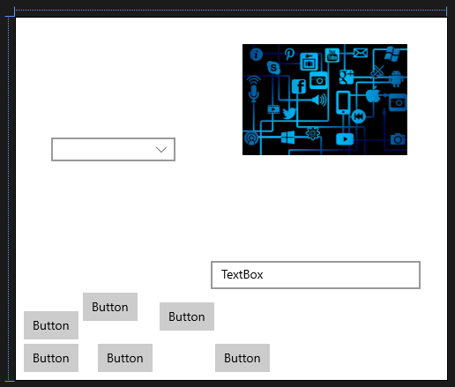
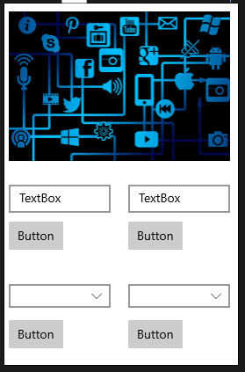
WPF GUI design
What makes a good User Interface ??
Minimize:
Input fields
Amount of buttons
Tabs:
Help with large amounts of data
Scale:
Scale background
Scale images
Scale input boxes
Align:
Proper Align all elements
Natural feeling

Slide 22
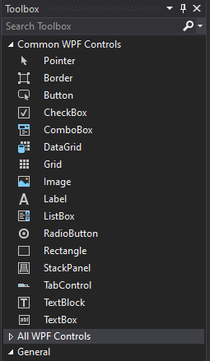
XAML Controls
A Control is a predefined GUI behavior component
Controls can be found in the toolbox within Visual Studio
Visual studio comes with approximately 50 controls
Free app to try controls and view code samples
https://www.microsoft.com/en-us/p/xaml-controls-gallery/9msvh128x2zt
Notes:
Additional controls available via Nuget:
Microsoft.UI.Xaml.Controls
Additional controls for UWP development are available from companies such as Telerik, SyncFusion, DevExpress, Infragistics, ComponentOne, and ActiPro.

Slide 23
Demonstration
Simple WPF GUI

Slide 24

Basic GUI controls
Element | Use Case | Visual Control | XAML Sample
Button | Pressed to trigger event |  | <Button Content="Button" />
Checkbox | Enable disable an option |  | <CheckBox Content="CheckBox" />
Radiobutton | Selecting a single option from multiple choice keep all options visible |  | <RadioButton Content="RadioButton" />
TextBox | Provide user with input field Can be prepopulated |  | <TextBox Text="TextBox"/>
PasswordBox | Input field with hidden characters |  | <PasswordBox Password=“Wel123"/>
Label | Visible Comment on a control Explanation for end user |  | <Label Content="Label“ />
Notes:
A good site to learn the controls and how they work
https://www.wpf-tutorial.com/

Slide 25
Demonstration
Basic GUI controls

Slide 26





Advanced / Grouping GUI controls
Element | Use Case | Visual Control | XAML Sample
TabControl | Providing multiple tabs to group actions or views together |  | <TabControl > <TabItem Header="Tab1"> </TabItem> </TabControl>
ComboBox | Selecting a single option from multiple choice Make all options visible when selecting and hide again on select |  | <ComboBox Width="180"> <ComboBoxItem Content="item1"/> </ComboBox>
StackPanel | Group object together in a stack A stack of radio buttons can have only 1 selected |  | <StackPanel> <RadioButton Content="Tiger"/> </StackPanel>
Menu | A menu with event driven triggers when clicked upon |  | <Menu> <MenuItem Header="MenuItem"/> </Menu>
DatePicker | Allows to select a date out of a calendar control that displays when clicking the date icon |  | <DatePicker/>
Notes:
A good site to learn the controls and how they work
https://www.wpf-tutorial.com/

Slide 27
Demonstration
Advanced / Grouping GUI controls

Slide 28
Questions?

Slide 29

Your first GUI

Slide 30
WPF / XAML GUI Workflow
GUI: Design
Design GUI on Paper / MS paint
Design your GUI in XAML editor
PowerShell: Prepare
Load needed assembly files
Prepare XAML code for PS usage
PowerShell: Load
Create an XML reader to load the XML data into usable PowerShell objects
Add PowerShell code to control the form
Read XAML code in PS as XML
PowerShell: Use
Preload values or run code
Display form
Close Form
Notes:
#1 Design your GUI , As a GUI is as good as your design always perdesign a GUI on paper / Mspaint or whatever you feel comfortable with. This give you the rough outlines of how it might look. Redesigning a Gui is very work extensive
#2 Design your GUI in XAML editor
#3 Load the needed Assembly files (presentationframework, presentationcore)
#4 Prepare XAML file for usage in Powershell
#4a Get the XAML into PowerShell as a string (can use Get-Content on a separate file)
#4b Scrub out any XAML stuff PowerShell doesn’t like (some of the Visual Studio bits)
#5 Typecast your string data to [XML]
#6 Build an XML reader and use it to load our XAML
#7. Add any code you want to control the form
#8. Display the Form to the user and dispose of it

Slide 31
XAML GUI for PowerShell
Name all controls and windows in the GUI
This will be used by PowerShell to create variables (Explained later)
Do not create any code behind the form (*.xaml.cs file)
This is the code that needs to be created in PowerShell
3rd party controls need to be added via PowerShell
This complicates the GUI and requires dependencies
During migration from VS to PowerShell, only use the *.xaml formatting code

Slide 32
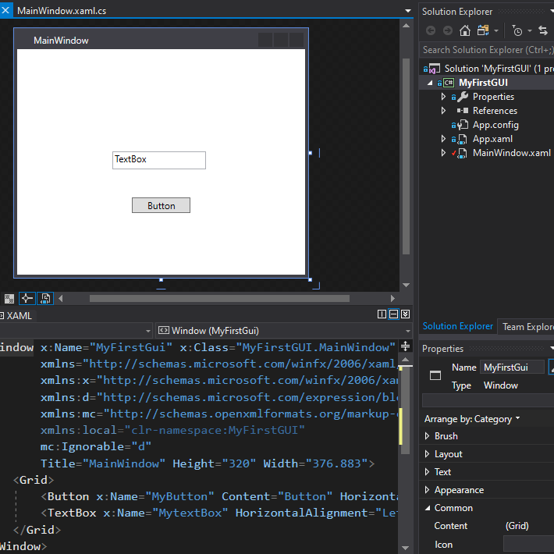
My First GUI - Sample
Notes:
The “x:Name” tags in the code is what we will use later to create corresponding PowerShell referencing objects for. Anything that is not named will not be created as a PowerShell object or will need manual referencing.

Slide 33
Preparing the XAML Code for PowerShell
VS adds headers not supported by Windows.Markup.XamlReader
#Add WPF assemblies
Add-Type -AssemblyName PresentationCore,PresentationFramework
#Cleanup XAML options
$XAML= [XML](Get-Content -Path '$PSScriptRoot\MainWindow.xaml' -Raw)
$XAML.Window.RemoveAttribute('x:Class')
$XAML.Window.RemoveAttribute('xmlns:local')
$XAML.Window.RemoveAttribute('xmlns:d')
$XAML.Window.RemoveAttribute('xmlns:mc')
$XAML.Window.RemoveAttribute('mc:Ignorable')
#read XML as XAML
$XAMLreader = New-Object System.Xml.XmlNodeReader $XAML
$Rawform = [Windows.Markup.XamlReader]::Load($XAMLreader)
Notes:
First, we add the assemblies needed to the runspace:
Add-Type -AssemblyName PresentationCore,PresentationFramework
Next, we remove the unwanted headers:
$XAML= [XML](Get-Content -Path '$PSScriptRoot\MainWindow.xaml' -Raw)
$XAML.Window.RemoveAttribute('x:Class')
$XAML.Window.RemoveAttribute('xmlns:local')
$XAML.Window.RemoveAttribute('xmlns:d')
$XAML.Window.RemoveAttribute('xmlns:mc')
$XAML.Window.RemoveAttribute('mc:Ignorable’)
We then read the XML as XAML – This is the Raw form we will be controlling
$XAMLreader = New-Object System.Xml.XmlNodeReader $XAML
$Rawform = [Windows.Markup.XamlReader]::Load($XAMLreader)

Slide 34
Converting GUI Form to Hash Table
Single hash table provides easy processing of PS code in code behind GUI
#add XML namespace manager
$XmlNamespaceManager = [System.Xml.XmlNamespaceManager]::New($XAML.NameTable)
$XmlNamespaceManager.AddNamespace('x','http://schemas.microsoft.com/winfx/2006/xaml')
#Create hash table containing a representation of all controls
$GUI = @{}
$namedNodes = $XAML.SelectNodes("//*[@x:Name]",$XmlNamespaceManager)
$namedNodes | ForEach-Object -Process {$GUI.Add($_.Name, $Rawform.FindName($_.Name))}
#Show GUI
$Rawform.ShowDialog()
Notes:
to be able to select nodes using namespace x: we need to add a namespace manager to the XML
$XmlNamespaceManager = [System.Xml.XmlNamespaceManager]::New($XAML.NameTable)
$XmlNamespaceManager.AddNamespace('x','http://schemas.microsoft.com/winfx/2006/xaml')
To create an entry in the hash table referencing all x:Name controls we loop thru the XML code. This is why all controls in VS need to be named.
$GUI = @{}
$namedNodes = $XAML.SelectNodes("//*[@x:Name]",$XmlNamespaceManager)
$namedNodes | ForEach-Object -Process {$GUI.Add($_.Name, $Rawform.FindName($_.Name))}
Display the form to the end user
$Rawform.ShowDialog()

Slide 35
Demonstration
Dissecting MyFirstGUI

Slide 36
Questions?

Slide 37

Advanced GUI Design

Slide 38
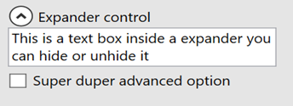
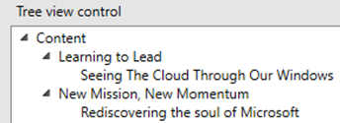

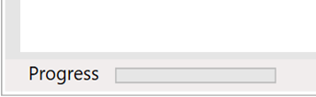
Visualization GUI controls
Element | Use Case | Visual Control | XAML Sample
Expander | Hiding options from the visual grid. Used for hiding advanced options by default |  | <Expander Header="Expander control"> <Grid Background="#FFE5E5E5"> </Grid> </Expander>
Treeview | Create menu like structures that are expandable |  | <TreeView> <TreeViewItem IsExpanded="True"> </TreeViewItem> </TreeView>
Separator | Separator line used to separate controls with a visual line / bar |  | <Separator/>
Progressbar | Display status of running tasks |  | <ProgressBar/>
WebBrowser | Load a webpage inside a WPF form |  | <WebBrowser Source="https://aka.ms"/>
Notes:
Note:
Single line items terminate at the end with “/”.
Multi line items terminate single new line with “/keyword”
A good site to learn the controls and how they work
https://www.wpf-tutorial.com/

Slide 39
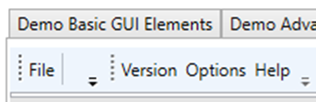
Dock Panel GUI controls
Element | Use Case | Visual Control | XAML Sample
Dockpanel | Used as an invisible container on the edge of other objects. Container for status bars and toolbars |  | <DockPanel> </DockPanel>
ToolBarTray | Container to hold the toolbars |  | <ToolBarTray> </ToolBarTray>
Toolbar | Creating dynamic tool bars with overflow that can be moved around |  | <DockPanel Margin="0,0,0,336"> <ToolBarTray DockPanel.Dock="Top"> <ToolBar/> </ToolBarTray> </DockPanel>
Statusbar | A bar at the bottom of a window Display Errors, Progress, Information |  | <StatusBar/>
StatusBarItem | A container inside the statusbar control that can hold a control |  | <DockPanel> <StatusBar DockPanel.Dock="Bottom"> <StatusBarItem/> </StatusBar> </DockPanel>
Notes:
Note:
Single line items terminate at the end with “/”.
Multi line items terminate single new line with “/keyword”
A good site to learn the controls and how they work
https://www.wpf-tutorial.com/

Slide 40
Demonstration
Advanced GUI Design

Slide 41
Questions?

Slide 42

Code Behind a Form

Slide 43





PowerShell as an Engine For WPF
Advantage:
PowerShell can be used as the engine behind the form
No need to learn other language to Power great visual forms
Disadvantage:
Well documented MSDN for all controls
All form code should be written before you display the form
No debugger available (Shell access lockout while form is visible)
PowerShell has no native form refresh as an asynchronous task

Slide 44
Control Properties
Controls have Properties you can change / update
Use Get-member to view Property types
PS C:\> $Gui.Inputtext.gettype().fullname
> System.Windows.Controls.textBox
PS C:\> $Gui.Inputtext | Get-Member -Type Property -name *Text*
> Name MemberType Definition
> ---- ---------- ----------
> ContextMenu Property System.Windows.Controls.ContextMenu ...
> DataContext Property System.Object DataContext {get;set;}
> SelectedText Property string SelectedText {get;set;}
> SelectionTextBrush Property System.Windows.Media.Brush Selection...
> Text Property string Text {get;set;}
> TextAlignment Property System.Windows.TextAlignment TextAli...
> TextDecorations Property System.Windows.TextDecorationCollect...
> TextWrapping Property System.Windows.TextWrapping TextWrap...

Slide 45
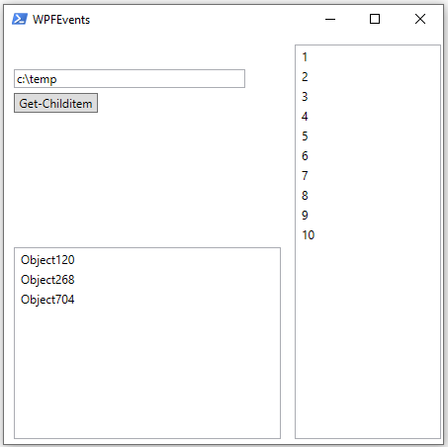
Programming Control Properties
Define properties before the form loads
Changing properties without form refresh wont show
Most events will trigger form refresh
PS C:\> $GUI.Inputtext.Text = "c:\temp"
PS C:\> 1..10 | %{$gui.Itemlist.Items.add($_)}
PS C:\> $1 = "Object120","Object268","Object704“
PS C:\> $1 | %{$gui.Detaileditemlist.Items.add($_)}

Slide 46
Event Driven Actions
Controls have events that can be used as triggers for code
Use Get-Member to view event types
PS C:\> $Gui.Get_childitem.gettype().fullname
> System.Windows.Controls.Button
PS C:\> ($Gui.Get_childitem | Get-Member -Type event).count
> 111
PS C:\> $Gui.Get_childitem | Get-Member -Type event -name *click*
> Name MemberType Definition
> ---- ---------- ----------
> Click Event System.Windows.RoutedEventHan...
> MouseDoubleClick Event System.Windows.Input.MouseBut...
> PreviewMouseDoubleClick Event System.Windows.Input.MouseBut...

Slide 47
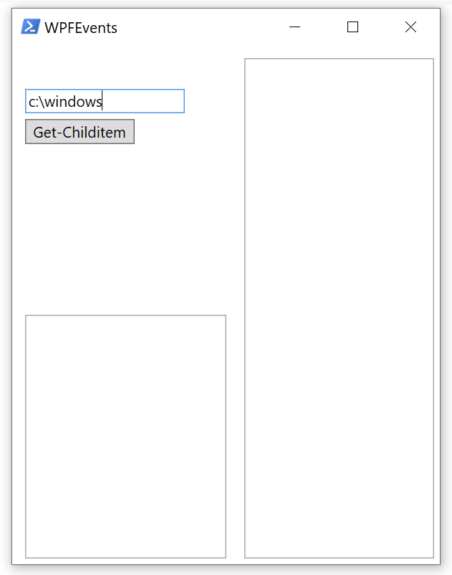
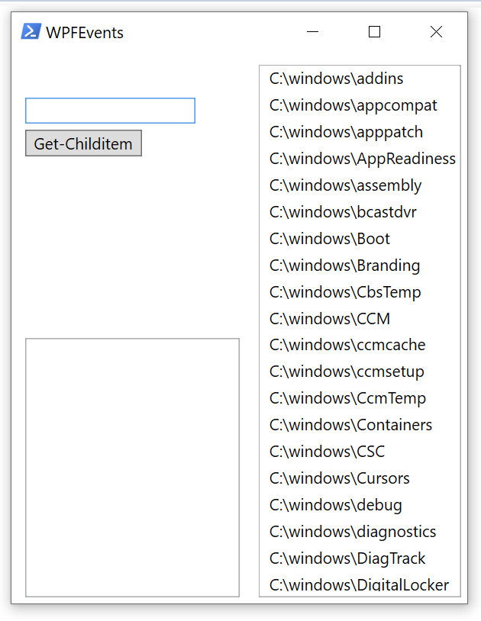
Programming Events
Event triggers are added to code using “Add_Eventname({Code})”
The Form is unresponsive during PowerShell code execution
$Gui.Get_childitem.Add_Click({
If (!([string]::IsNullOrEmpty($Gui.Inputtext.text)))
{
$childitems = Get-ChildItem –Path $Gui.Inputtext.text
foreach ($item in $childitems)
{
$Gui.Itemlist.Items.Add($item.fullname)
}
$Gui.Inputtext.Clear()
}
})
Notes:
Note that running long code execution might be perceived by a user as a hanging / crashing form.

Slide 48
Demonstration
Code Behind a Form

Slide 49
Data Binding
A functionality to update a control when the source it points to changes
Updating source can cause a chain of other controls to get updated automatically
Ways to declare data binding
Directly in XAML referencing an other control as source
In PowerShell code referencing a PowerShell variable object
A data bind can be used by all children of the parent

Slide 50
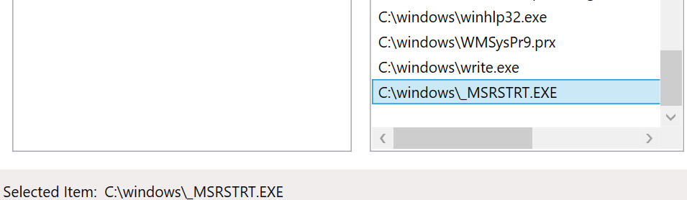
XAML Based Data Binding
Declared in XAML code
Only works on form refresh
Anything selected in “Itemlist” will be displayed in the text property of “Itemlistdisplay”
<ListBox x:Name="Itemlist" Width="250" AllowDrop="True"/>
<TextBlock x:Name="Itemlistdisplay" TextWrapping="Wrap"
Text="{Binding ElementName=Itemlist, Path=SelectedItem, Mode=OneWay }"/>

Slide 51
PowerShell Based Data Binding
Declared within PowerShell code
Displays on form refresh or via Asynchronous process
# Create a datacontext for the textbox and set it
$DataContext = New-Object System.Collections.ObjectModel.ObservableCollection[Object]
$DataContext.Add((get-date -f HH:mm:ss))
$Gui.timebox.DataContext = $DataContext
# Create and set a binding on the textbox object
$Binding = New-Object System.Windows.Data.Binding
$Binding.Path = "[0]"
$Binding.Mode = [System.Windows.Data.BindingMode]::OneWay
[void][System.Windows.Data.BindingOperations]::SetBinding($Gui.timebox, [System.Windows.Controls.TextBox]::TextProperty, $Binding)
Notes:
The “text” property of $Gui.timebox will be bound to $DataContext PS variable. The source object always needs to be in the form of a Collection , List, Array kind of variable.

Slide 52
Demonstration
Data Binding

Slide 53
Questions?

Slide 54
Advanced Techniques

Slide 55



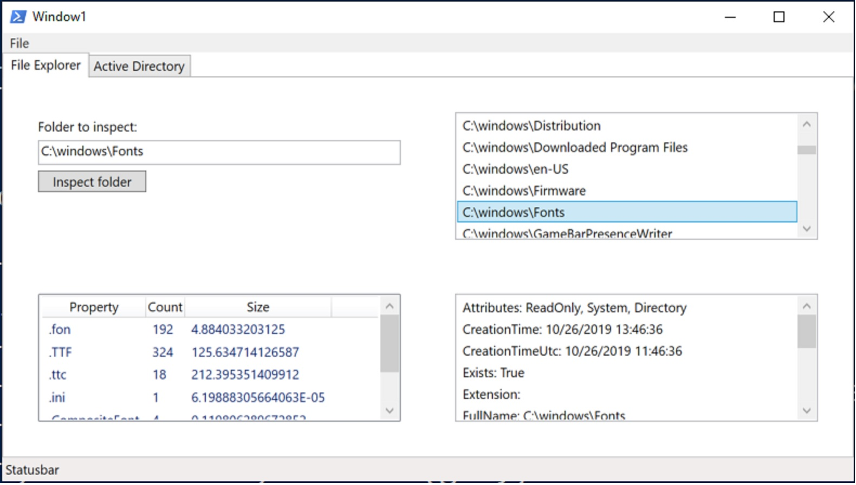
Why Does My GUI Get Unresponsive
XAML in PowerShell runs by default on the PS thread
PS is either updating the form or running the code behind
Techniques to overcome GUI locks due to running code:
Creating timers
Use Background workers
Use Runspaces
Mix of the above

Slide 56
Creating Timers
Easy to implement
Run in a dispatcher queue
Timer guarantees only interval has elapsed
Exact start time is not guaranteed
Used for short and fast running code
Maximum of ~2 sec runtime
Notes:
Timers will create a code execution on the queue meaning it will freeze form but running short code can support form updates making it look like form is not frozen.

Slide 57
Creating Timers - Example
$rawform.add_sourceinitialized({
#create timer object
$timer = new-object System.Windows.Threading.DispatcherTimer
$timer.interval = [timespan]"0:0:1"
#add event per tick
$timer.add_tick({
$DataContext[0] = get-date -f HH:mm:ss
})
$timer.start()
})
Notes:
The Timer itself does not prevent locks of the GUI but it can be used to update the form in between long running tasks or support a runspace to update the form thread itself while the runspace is processing the data.

Slide 58
Use a Runspace for GUI
More code overhead needed to synchronize data between threads
Runs in a separate .Net Runspace
GUI will not lock up as it has its own thread
Used to isolate the GUI processing from PowerShell code
Can be used to run single, longer running processes while GUI remains responsive
PowerShell console remains responsive for additional input
Used to initialize Form or run data updates in background
Notes:
The GUI runs in a runspace.
This provides the advantage that the powershell thread can be use for long running initiation processes or continues data pull events. (Example refesh data from a API.)

Slide 59
Use a Runspace to Run WFP GUI - Example
$Rawform = [hashtable]::Synchronized(@{})
$GUI = [hashtable]::Synchronized(@{})
$GUIRS = [hashtable]::Synchronized(@{})
$GUIRS.psscriptroot = $PSScriptRoot
$GUIRS.runspace = [RunspaceFactory]::CreateRunspace()
$GUIRS.runspace.ApartmentState = “STA”
$GUIRS.runspace.ThreadOptions = “ReuseThread”
$GUIRS.runspace.Open()
$GUIRS.runspace.SessionStateProxy.SetVariable("Rawform",$Rawform)
$GUIRS.runspace.SessionStateProxy.SetVariable("GUIRS",$GUIRS)
$GUIRS.runspace.SessionStateProxy.SetVariable("GUI",$GUI)
$GUIRS.psCmd.Runspace = $GUIRS.runspace
$GUIRS.Handle = $GUIRS.psCmd.AddScript({......}).BeginInvoke()
Start Runspace Async
WPF code goes here

Slide 60
Demonstration
Advanced Techniques

Slide 61
Questions?

Slide 62

PowerShell Graphical User Interfaces

Slide 63
Microsoft

